Slide 1
Should Namibia Continue to Rely on its Neighbours for Electricity
Paul Tuson PrEng MSc MBL
Notes:
Good morning ladies and gentleman, it is a pleasure to be here with you all. I really love coming to Windhoek and Namibia. The people are friendly and Namibia is like one big game reserve with beautiful trees, birds and animals.

Slide 2
Introduction
Namibia Economic Situation
Namibia Electricity Situation
South Africa Economic Situation (Fitch/Moodies/S&P)
South Africa Electricity Situation
Problems with Eskom
Rising Debt
Lack of Maintenance
Cost over-runs
Unsustainable Costs
Corruption
Trade Unions
Utility Death Spiral
Increase in VRE and Battery Storage
Utilities of the future
Notes:
I’ll start the presentation by very briefly reviewing Namibia’s GDP and energy situation, however I think there are people in the room who are more qualified at discussing Namibia’s economic then me.
I’ll then briefly discuss South Africa’s economic and electricity situation and follow this with discussing major problems that Eskom is currently experiencing including:
Rising debt
Maintenance shortfalls
Cost over-runs on large power plants like Medupi, Kusile and Ingula
Unstainable costs including salary costs
Corruption
Skills erosion
I briefly discuss the concept of the utility death spiral
And the energy revolution including solar, wind and battery energy storage
And lastly I discuss how utilities will survive into the future by changing their business model

Slide 3
Namibia Economic Situation
Notes:
Brief review of Namibia’s economic situation

Slide 4
Namibia GDP (USDbn) and GDP Growth in %
Source: NamPower Annual Report 2018
Notes:
The figure shows the historical GDP and historical GDP percentage growth from 1990 to the present.
The GDP in Namibia has grown from USD3bn to USD15bn.
The GDP percentage growth has hovered between 3% and 8% with very low to negative GDP growth rates in 1993, 2009 and 2017.
Projected GDP growth rates to 2023 are 3%.
If these GDP growth rates are correct and if energy growth and GDP growth are correlated, Namibia can expect electricity energy usage to continue.

Slide 5
Namibia Electricity Situation
Notes:
I’ll briefly discuss the Namibian Electricity situation

Slide 6
NamPower Units into the System (GWh)
Source: NamPower Annual Report 2018
Notes:
Namibia’s energy usage has been steadily growing from 2000GWh in 1997 to approximately 4700GWh in 2018 according to the NamPower annual report.
Also shown on the figure, are the growth in imports from Eskom and other sources. This will be discussed further in the next slides.

Slide 7
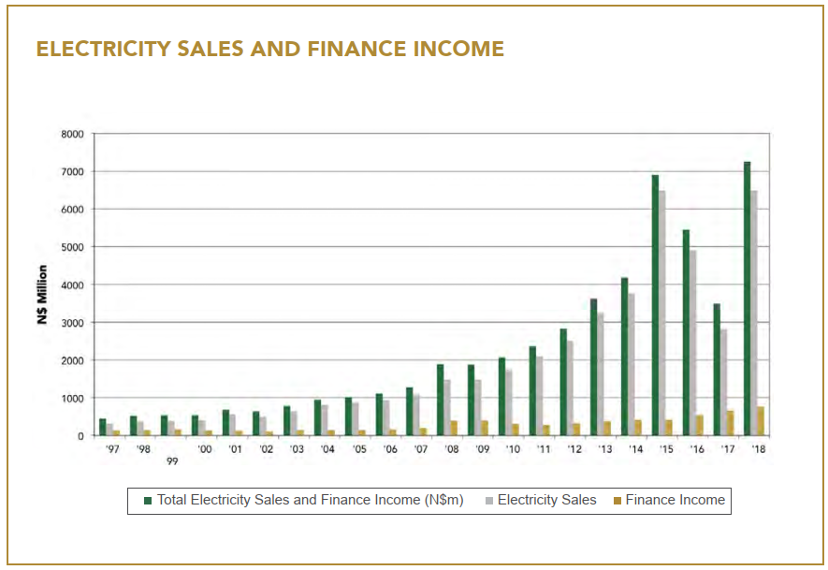
Electricity Sales and Income (N$m)
Source: NamPower Annual Report 2018
Notes:
NamPower’s electricity sales and income in Namibian dollars have also been growing from N$400m to N$7.2bn from 1997 to 2018.
A revenue spike occurred in 2015 and almost a 50% drop in revenue occurred in 2017.

Slide 8
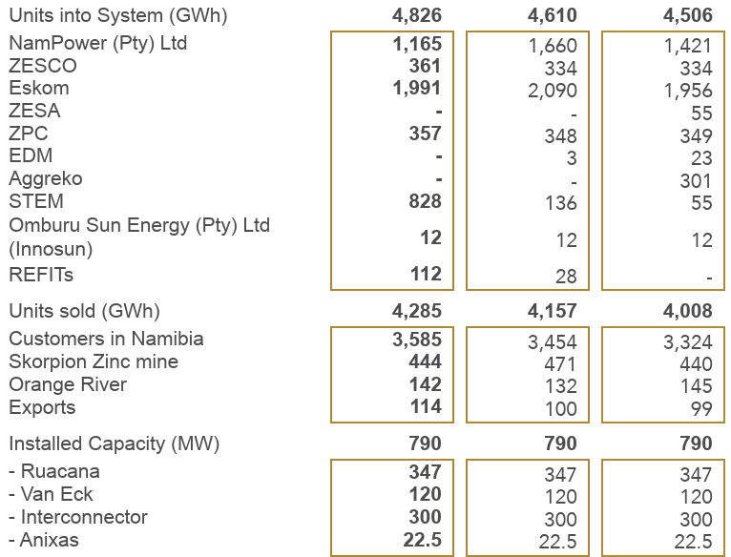
Statistics – NamPower 2018 Annual Report
Source: NamPower Annual Report 2018
Notes:
The three red circles show some recent deviations from historical trends in 2018.
NamPower generation dropped by 30% in 2018 compared with 2017.
Eskom imports exceeded Namibia generation by over 70% in 2018.
Short Term Energy Market (STEM) imports grew by a massive 50% in 2018 to 828GWh GWhs. (70% of NamPower generation).
Renewable Energy generation grew by 300% to 112GWh (10% of NamPower generation).
Only one quarter of Namibia’s energy was provided by NamPower in 2018.

Slide 9
NamPower Generation and Imports 2018
Source: NamPower Annual Report 2018
*STEM – short term energy markets (bilateral contracts take precedence over STEM
Imports = 73%
Notes:
The pie graph shows the large Eskom GWhs in grey (almost half) and the large STEM, ZESCO (orange) and ZPC (light blue) imports.

Slide 10
South Africa Economic Situation
Notes:
Perhaps more of interest to Namibian citizens is the situation that is prevailing in South Africa.

Slide 11
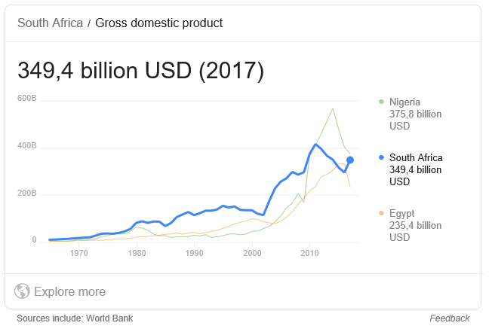
South Africa Historical GDP
Source: World Bank
Notes:
South Africa’s GDP was USD349.4bn in 2017, more or less the same as Nigeria and Egypt.

Slide 12
South Africa Investment Grading – Baa3
In the last week, South Africa has just staved off an downgrade by Moody’s to sub-investment grade.
Source: Moneyweb
Notes:
South Africa’s GDP was USD349.4bn in 2017, more or less the same as Nigeria and Egypt.

Slide 13
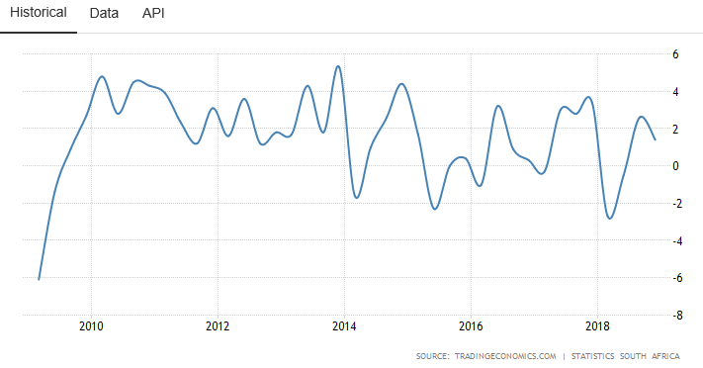
South Africa Historical GDP Growth Rate (Real) in %
Source: Statistics South Africa
Notes:
South Africa’s GDP growth has been hovering around zero per cent since 2015 and from 2010 to 2014 hovered around 2% growth.
A brave man (or woman) may want to predict South Africa’s GDP growth rate going forward, taking into account recent dysfunctional mining legislation and a shrinking mining industry, bankrupt State Owned Enterprises (SOEs), national, provincial and municipal corruption, an intransigent labour movement, climate change factors, etc.
One scenario is that South Africa’s GDP will continue to hover around zero per cent growth for the foreseeable future.

Slide 14
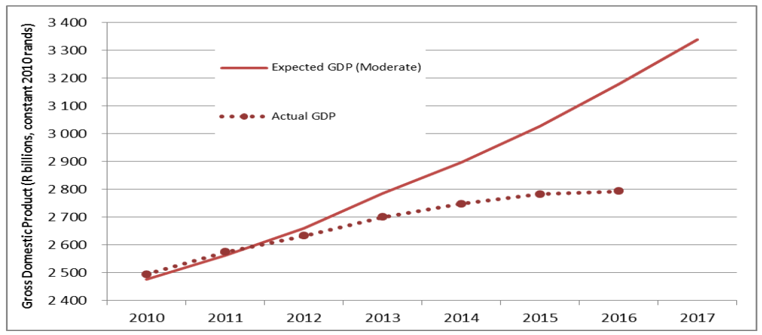
Expected GDP growth from IRP 2010 vs Actual (Statistics SA)
Source: IRP Update Draft Report 2018
Notes:
The Integrated Resource Plan (IRP) 2010 predicted a steady growth in GDP, the actual has been different.

Slide 15
South Africa Electricity Situation
Notes:
Now I’ll move onto the South African electricity situation.

Slide 16
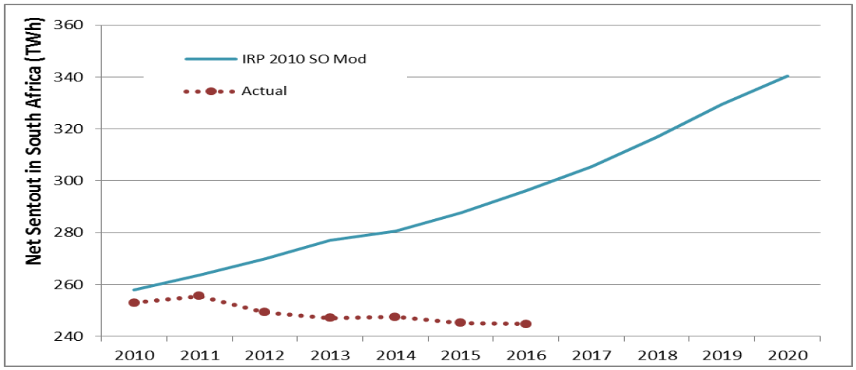
Expected Electricity Sent Out IRP 2010 vs Actual (Statistics SA)
Source: IRP Update Draft Report 2018
Notes:
The South African IRP 2018 Draft Report shows the expected growth in electricity sent out in TWhs.
The reality has been sadly different and as demand side management initiatives increase, as IPPs embedded RE generation increases and as economic activity declines, or stays level, growth in electricity sent out is likely to stay level or even continue to decrease in the short and medium term.

Slide 17
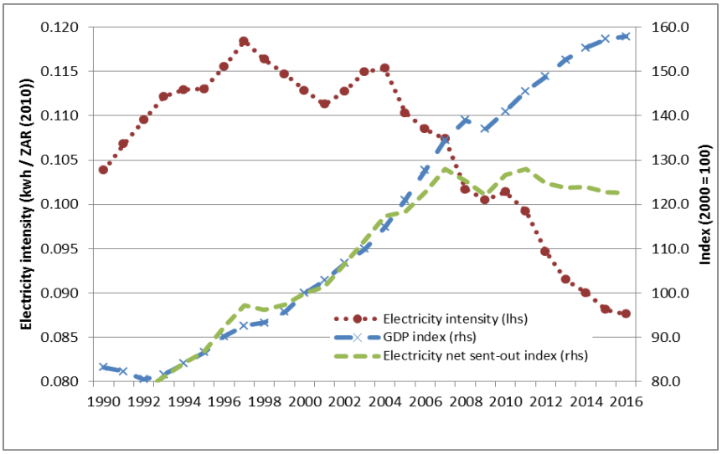
Electricity Intensity 1990 - 2016
Source: IRP Update Draft Report 2018
Notes:
Compounding the above negative projections in electricity growth is the decrease in electricity intensity in South Africa as shown by the red, dotted line.
In fact in the past ten years, electricity intensity has decreased, electricity sent out has decreased and GDP has levelled.
Therefore, with Medupi (4800MW), Kusile (4800MW) and Ingula (1332MW) power plants (11GW), Eskom should be in a very comfortable position with sufficient reserves and energy and capacity to export.

Slide 18
Problems with Eskom
Rising Debt
Lack of Maintenance
Cost over-runs
Unsustainable Costs
Corruption
Trade Unions

Slide 19
Problems with Eskom
Rising Debt

Slide 20
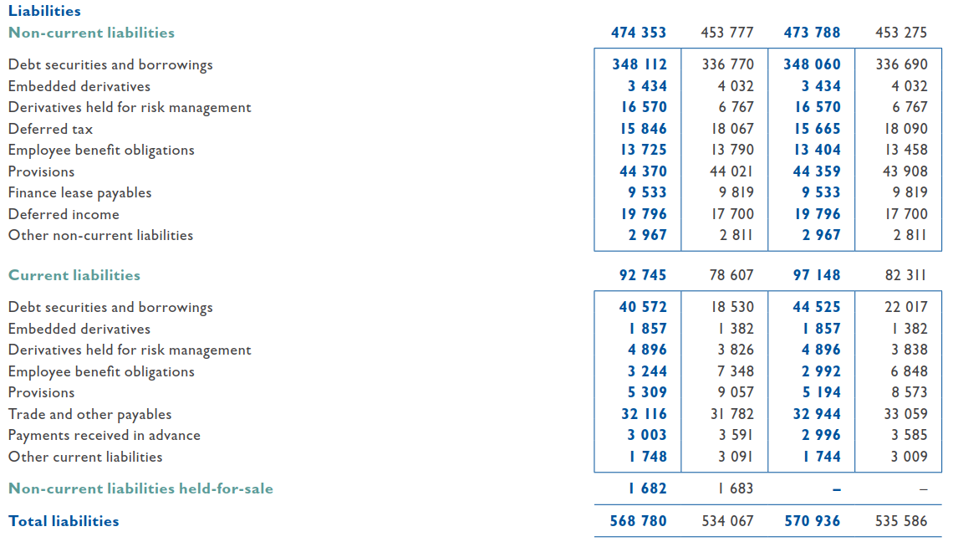
Eskom Liabilities 2017/2018 (ZARm)
Source: Eskom 2018 Annual Integrated Report
Notes:
The figure shows Eskom’s debt securities and borrowings in 2018 to be ZAR348bn.
Total liabilities comprise ZAR568bn.

Slide 21
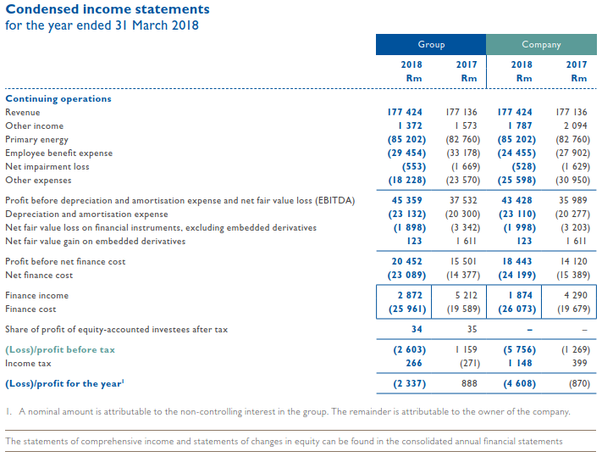
Eskom Income Statements 2018 (ZARm)
Source: Eskom 2018 Annual Integrated Report
Notes:
Against the total liabilities of ZAR568bn, Eskom’s revenue for 2018 was ZAR177bn and its financing costs were ZAR26bn.
Eskom’s loss for 2018 was ZAR2.3bn.

Slide 22
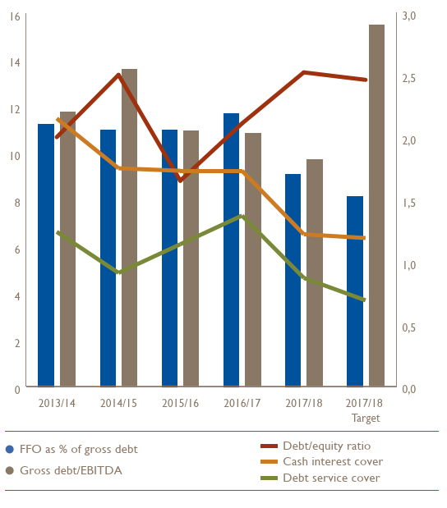
Eskom Financial Ratios 2018
Source: Eskom 2018 Annual Integrated Report
Notes:
Financial ratios paint an even bleaker picture.
Eskom’s debt service cover has dropped to less than 0.7 (green line) and Eskom’s cash interest cover is approaching 1.0.
Eskom’s Gross debt/EBITDA is nearly double its cashflow.
One way out of this hole is for Eskom to significantly increase GWh sales.

Slide 23
Eskom 10 year statistics
Source: Eskom 2018 Annual Integrated Report
Notes:
The figure shows Eskom’s GWh sales in 2018 less than its GWh sales in 2008.
GWh sales have stayed flat for over ten years.
Another way for Eskom to improve its financial situation is to cut costs and increase electricity tariffs and so improve revenue and profitability.

Slide 24
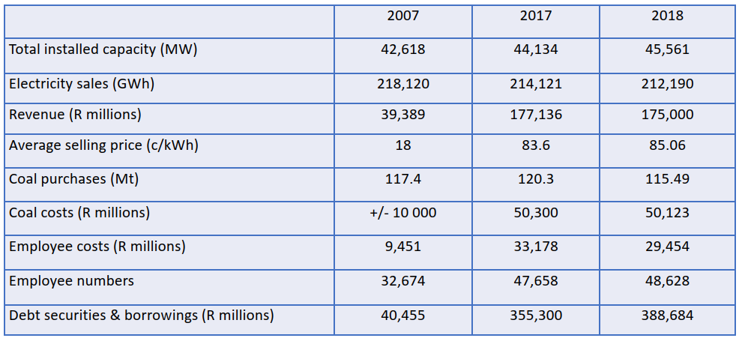
Eskom Statistics
Source: SAIEE/EE Publishers Seminar/Panel Discussion 2018 and Eskom Annual Report 2018
Notes:
The figures in the table are extracted from Eskom’s 2018 annual report.
Installed capacity has stayed almost unchanged in over ten years.
GWh sales have reduced.
Revenues have increased as a result of four-fold increase in tariffs.
Coal costs have more than quadrupled.
Employee numbers have significantly increased (while installed capacity and GWh sales have remained unchanged) and employee costs have tripled.
Debts have grown by a factor of ten.
But revenues are not enough to cover debt and increased tariffs are threatening Eskom’s survival and increasing defection.

Slide 25
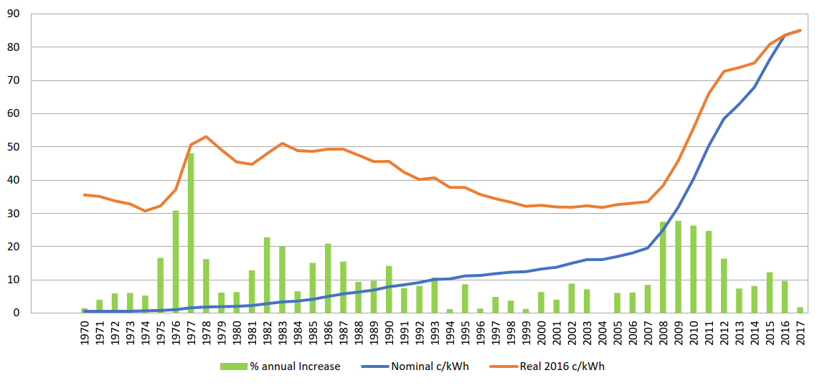
Eskom Historical Tariffs (Real (orange) and Nominal (Blue)
4 x nominal in last 10 years
3 x real in last 10 years
Source: SAIEE/EE Publishers Seminar/Panel Discussion 2018
Notes:
The figure shows Eskom’s tariff increases since 1970.
In the last ten years, nominal tariffs have increased four times and real tariffs have increased three times.

Slide 26
Further Problems with Eskom
Cost over-runs
Notes:
In this part of the presentation, I discuss further systemic problems with Eskom.
The first is cost over-runs on the large Medupi, Kusile and Ingula projects.

Slide 27
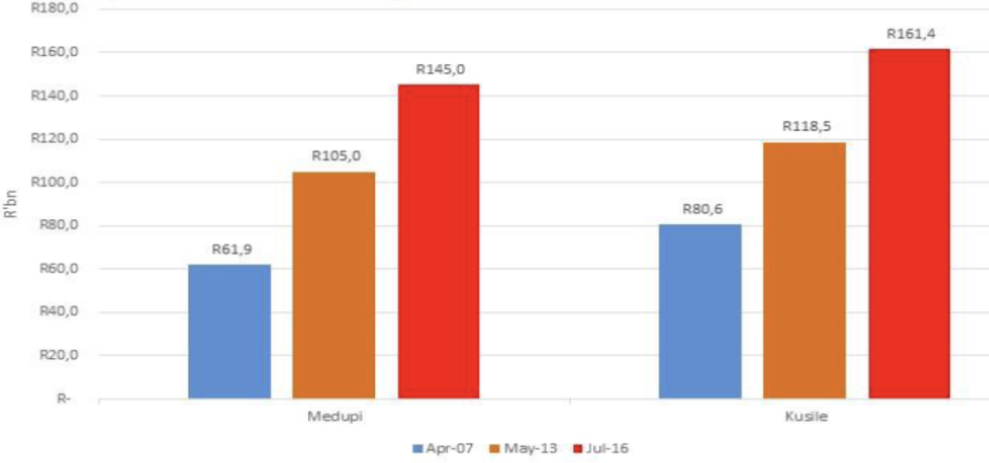
Cost overruns at Medupi and Kusile
Source: SAIEE/EE Publishers Seminar/Panel Discussion 2018
Notes:
These slides show the costs of Medupi and Kusile from the time the projects commenced to 2016.
Costs for Medupi have more than doubled and costs for Kusile have doubled. These large 4800MW power stations are still not completed so these graphs will get even worse. While the projects are delayed, contractors have to be paid, interest has to paid and revenue is not received.
These projects have taken more than twice the time to complete as originally planned.
The problems with these projects started before the contracts for the boilers were even signed with political interference in the appointment of Hitachi South Africa. Chancellor House, is the ANC’s “investment company”. Chancellor House had a 25% shareholding in Hitachi South Africa.

Slide 28
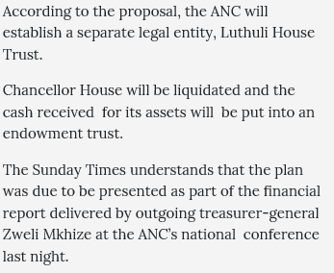
Hitachi and Chancellor House - Medupi and Kusile
“For nearly a decade, the South African branch of Japanese giant Hitachi lied, obfuscated and denied. And other than a minor slap on the wrist for ANC stalwart Valli Moosa, neither Hitachi nor the ANC or its funding front Chancellor House suffered any repercussions.
But on Monday that changed dramatically, when Hitachi offered to pay $19-million (about R266-million) to make an investigation by United States regulators go away.”
Source: Mail & Guardian Sept 2015
Source: Times Live Dec 2017
Notes:
This slide shows an extract from the Mail & Guardian’s website in September 2015.
Hitachi South Africa offered to pay $19m to make an investigation by US regulators go away
In 2017, ANC tried to sanitise itself by liquidating Chancellor House placing the cash received in a trust called: “The Luthuli House Trust”.
Eskom’s 1332MW Ingula Pumped Storage project in Kwazulu Natal was also delayed by several years and claims were also made about corrupt tender awards (BusinessTech, March 2019)

Slide 29
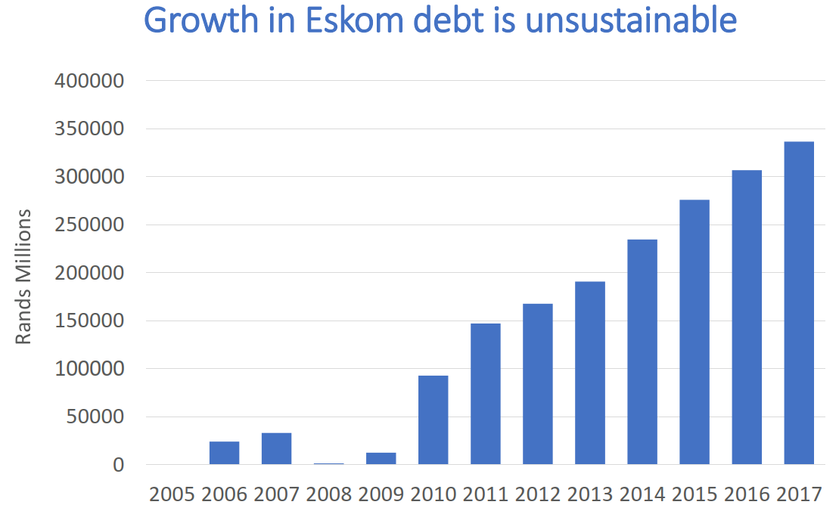
Eskom Debt
Source: SAIEE/EE Publishers Seminar/Panel Discussion 2018
Notes:
As mentioned, Eskom’s debts are subsequently unstainable.
If Standard an Poor, Fitch or Moody’s downgrade South Africa’s credit rating, cost of debt will become even more expensive.
Eskom’s credit rating is also precarious. S&P has Eskom’s foreign and local currency long-term ratings at CCC+, with a stable outlook. A CCC rating means that Eskom is vulnerable and dependent on favourable business, financial and economic conditions to meet its financial commitments.

Slide 30
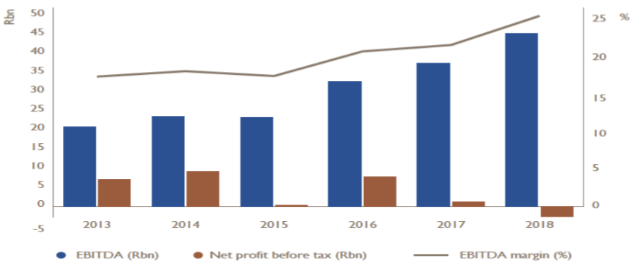
Eskom losses – likely to increase
Source: SAIEE/EE Publishers Seminar/Panel Discussion 2018
Notes:
Eskom’s losses are likely to increase.

Slide 31
Problems with Eskom
Lack of Maintenance
Notes:
The next slides briefly touch on power plant maintenance risks with Eskom.
Municipalities in South Africa are also at risk resulting from years of under-investment, corruption and delays in maintenance.

Slide 32
Eskom Maintenance
Maintenance delayed due to poor performance of Medupi and Kusile and late commissioning of Ingula Pumped Strorage Power Station
Lack of funds
Lack of skills
Notes:
Because of the size and importance of Medupi and Kusile power stations (9.6GW) , necessary maintenance funding has been funnelled towards getting these two power projects running and maintenance at Eskom’s older power plants has been delayed or deferred in many cases.
In March, South African experience two weeks of Stage 4 load shedding. At one point, only 18GW of generation was available on a 45GW system.

Slide 33
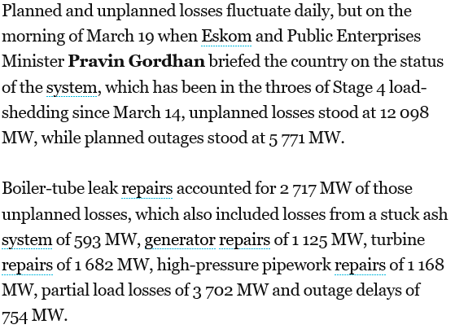
Eskom Outages
Source: Engineering News – March 2019
Notes:
This slide is an extract from the Engineering News in March 2019, and details the causes of large-scale outages at Eskom power plants.
At one point, 12GW of power plant was out of service due to unplanned outages.
Boiler tube leak repairs accounted for 2.7GW of outages.
Stuck ash accounted for 593MW.
Times Live reported in January 2018, that “Eskom has agreed to allow Gupta-owned mining company Tegeta Resources and Exploration to deliver lower quality coal, at a more expensive rate, to its Hendrina power station in a show of the family’s continued influence at the power utility”

Slide 34
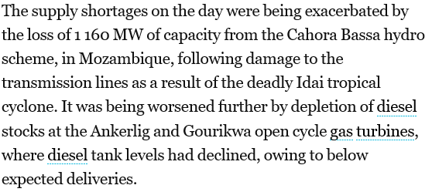
Eskom Outages
Source: Engineering News – March 2019
Notes:
In addition to coal generation outages, the IDAI cyclone damaged HVDC power lines from Cahora Bassa hydro power plant to the Apollo substation in South Africa, taking a further 1160MW off the system.

Slide 35
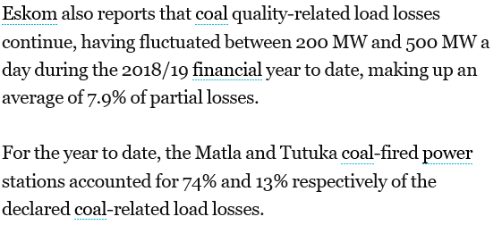
Eskom Outages
Source: Engineering News – March 2019
Notes:
The methodology of contracting for coal has been widely criticised in South Africa both on technical, commercial and ethical grounds.

Slide 36
Trade Unions and Eskom
Trade Unions are attempting to protect Eskom jobs
BusinessTech, February 2019: “Trade unions ready to fight against Eskom split”.
Source: BusinessTech, February 2019
Notes:
While Eskom is selling less energy than it did ten years ago, it has significantly more staff at significantly inflated salaries.
Trade unions know they have cushy jobs and are resisting any attempts to down-size or restructure Eskom.
What they don’t understand is that preserving 5000 jobs at Eskom can lose 100,000 jobs in the economy due to loadshedding, high tariffs and unreliable services.

Slide 37
Utility Death Spiral

Slide 38
Utility Death Spiral
Costs and Tariffs
KWh Sales and Revenue
Customers defect as tariffs increase
Revenues decrease further and tariffs need to increase
“Utility Death Spiral”
Notes:
The utility death spiral is a phenomenon happening in every country in the world and in every vertically integrated and state-owned utility in the world.
Due to inefficiencies, costs rise which force an increase in tariffs.
As a result, customers defect to other technologies e.g. solar PV and battery energy storage.
Utility revenues decrease further from the defection, but the utilities still need to maintain the assets, even though they are earning less income on kWh sales.
The utilities need to then increase their tariffs, and more customers defect.
Eventually the utility becomes technical insolvent and either needs a government bail-out or needs to be restructured.

Slide 39
Eskom structure and rapidly changing electricity market
Source: SAIEE/EE Publishers Seminar/Panel Discussion 2018
Notes:
The old vertically integrated model is no longer fit for purpose
Changes in ICT technologies and sophisticated financial markets mean that:
Economies of scale no longer competitive
Gas, VRE and storage technologies are modular, fast and cost effective
Power systems are increasingly decentralised
ICT innovation allows for system coordination even after unbundling
Growth in financial markets has generated a range of new sources for finance
Other than transmission, the electricity sector is no longer considered a natural monopoly. It is possible to have competition in generation and distribution

Slide 40
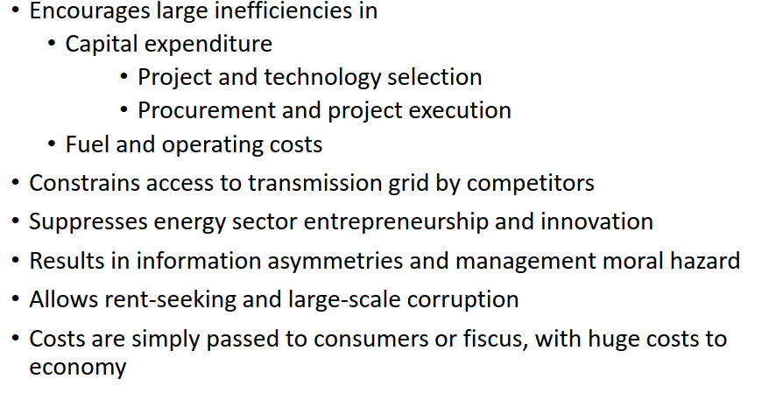
Absence of competition in industry:
Source: SAIEE/EE Publishers Seminar/Panel Discussion 2018
Notes:
Absence of competition in industry:
encourages last inefficiencies in capital expenditure and in fuel and opeating costs
Constrains access to the grid by competitors
Suppresses energy sector innovation
Encourages costs to be simply passed to consumers or the fiscus, with huge consequences

Slide 41
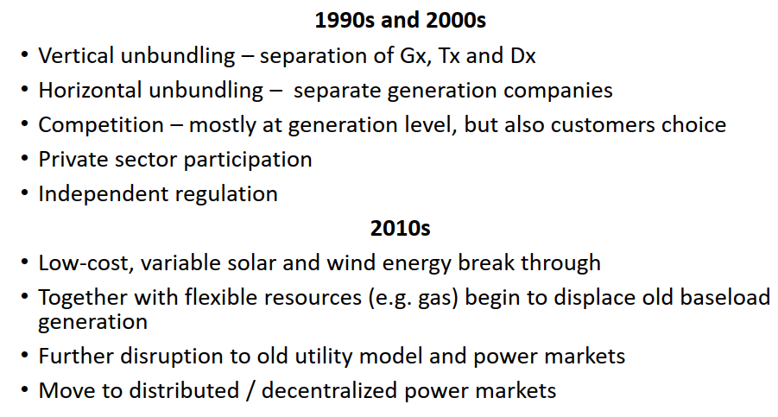
Power sector reforms internationally
Source: SAIEE/EE Publishers Seminar/Panel Discussion 2018
Notes:
This figure shows the reform of the power sector in recent time.
In the 1990’s and 2000’s unbundling, competition and private sector participation happened and independent regulators were set up.
In this decade, low cost VRE made a breakthrough, and flexible gas with storage technologies have started displacing old baseload generation.
There has also been a moved to distributed and decentralised power markets.

Slide 42
VRE and Storage Revolution
Source: SAIEE/EE Publishers Seminar/Panel Discussion 2018
Notes:
I have a few slides discussing the VRE and storage revolution.

Slide 43
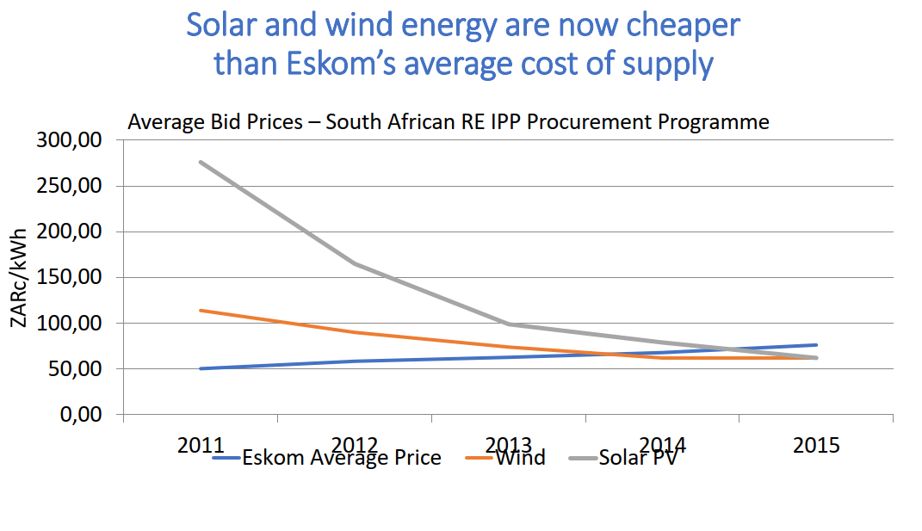
Prices of Variable Renewable Energy (VRE)
Source: SAIEE/EE Publishers Seminar/Panel Discussion 2018
Notes:
Prices of wind and solar continue to drop.
Wind and solar are now cheaper than Eskom’s average cost of supply.

Slide 44
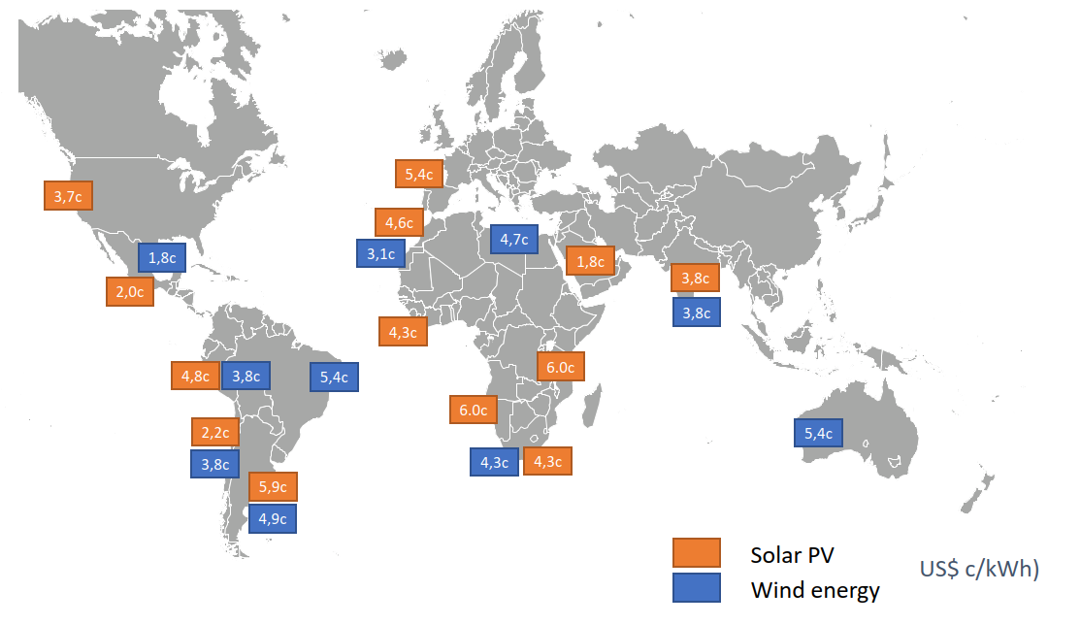
Prices of Variable Renewable Energy (VRE)
Source: SAIEE/EE Publishers Seminar/Panel Discussion 2018
Notes:
In some parts of the world, wind and solar prices are as low as USc1.8/kWh, the USA for wind and the Middle East for solar.

Slide 45
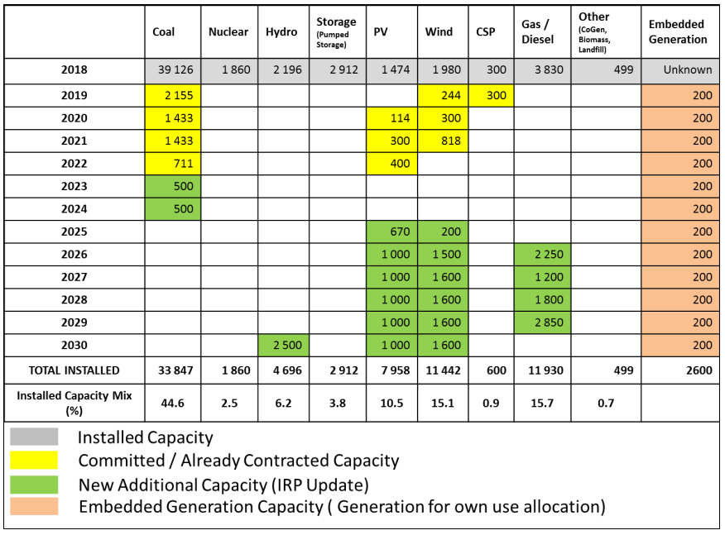
IRP recommended updated plan to 2030
Source: IRP Update Draft Report 2018
Notes:
Plexos models are choosing wind and solar as the least cost energy option.
The anti-correlation of wind and solar is helping to make VRE more dispatchable.
This figure is from the IRP update draft report 2018 in South Africa.

Slide 46
Utilities of the Future
Source: SAIEE/EE Publishers Seminar/Panel Discussion 2018
Notes:
Where are utilities headed in the future?

Slide 47
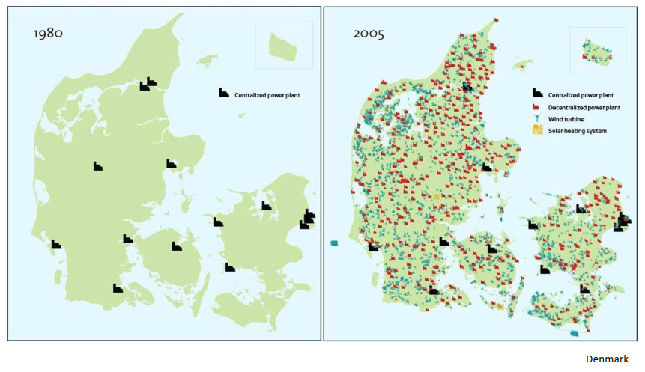
More VRE
Source: SAIEE/EE Publishers Seminar/Panel Discussion 2018
Notes:
More VRE is being installed. The figure shows Denmark from 1980 to 2005.

Slide 48
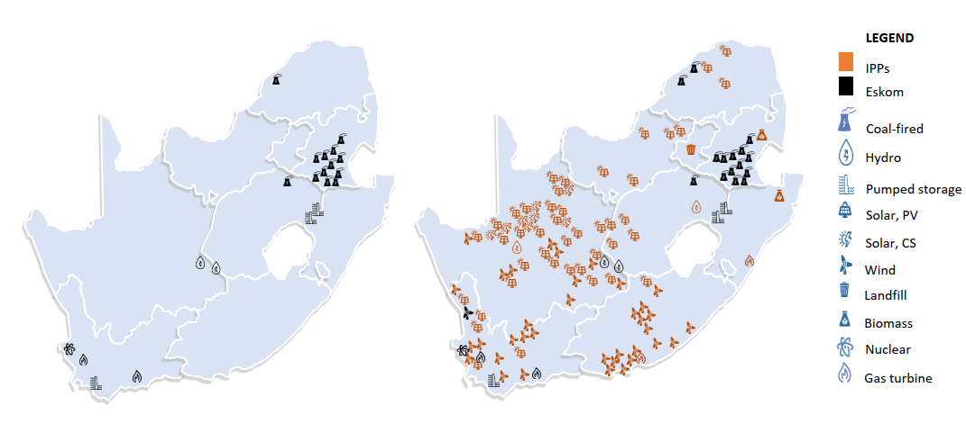
More VRE
Source: SAIEE/EE Publishers Seminar/Panel Discussion 2018
Notes:
A similar picture is happening in South Africa.

Slide 49
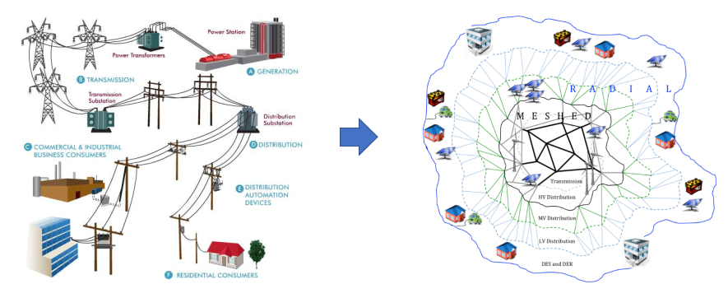
Old power sector structure and new meshed structure
Source: SAIEE/EE Publishers Seminar/Panel Discussion 2018
Notes:
The old uni-directional and linear power sector structure is changing to a meshed and bi-directional structure

Slide 50
Bi-directional power flows and EVs
Source: SAIEE/EE Publishers Seminar/Panel Discussion 2018
Notes:
Electric vehicles can be used for ancillary services.

Slide 51
No longer utilities selling kWhs but platform providers who trade ancillary services
Source: SAIEE/EE Publishers Seminar/Panel Discussion 2018
Notes:
Utilities will no longer make and sell kWhs but will provide platforms for other users and will trade ancillary services.

Slide 52
Lessons for Namibia
Source: SAIEE/EE Publishers Seminar/Panel Discussion 2018
Notes:
So what are the lessons for Namibia?

Slide 53
Lessons for Namibia
Don’t rely on neighbours for capacity
Be capacity independent but buy cheap energy from SAPP when available
Develop indigenous synchronous/dispatchable generation to run in conjunction with VRE generation
Affordable gas generation (flexible and low capex)
Reservoir hydro storage
Both these technologies are synchronous and provide inertia and fault level
Not possible to fight the VRE/Storage revolution
Restructure
Innovate (ICT, financial, technical)
Source: SAIEE/EE Publishers Seminar/Panel Discussion 2018
Notes:
So what are the lessons for Namibia, possibly:
Don’t rely on your neighbours for capacity, they have growing populations and economies and their own challenges
Be capacity independent but import los-cost electricity from SAPP when available or on commercially advantageous bilateral contracts or STEM. Note that STEM may not last forever and may come and go
Also plan to be self-sufficient when in an island condition
Develop indigenous synchronous capacity in a least cost way. Use software e.g. Plexos that looks at VRE intermittency, correlations, and least cost long term planning and least cost planning
Gas is a good generation technology to complement the variability of VRE
As is hydro reservoir generation
Gas and hydro generation are synchronous generation and are dispatchable and provide system inertia and fault level
The VRE and battery storage revolution is coming as cost continue to drop, don’t fight it but manage it
Consider restructuring with and ISMO or an ITSMO. IPPs can bring generation technology on line faster and cheaper
Be innovative e.g. encourage wheeling, use existing capacity for trading
Charge for ancillary services, etc.

Slide 54
Thank you

Slide 55
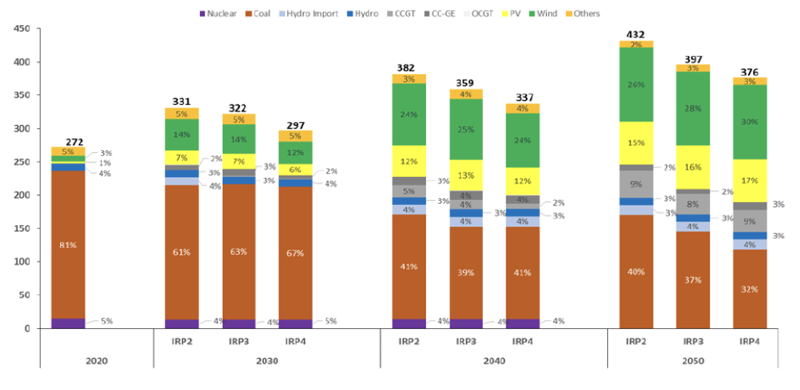
Eskom losses – likely to increase
Source: SAIEE/EE Publishers Seminar/Panel Discussion 2018

Slide 56
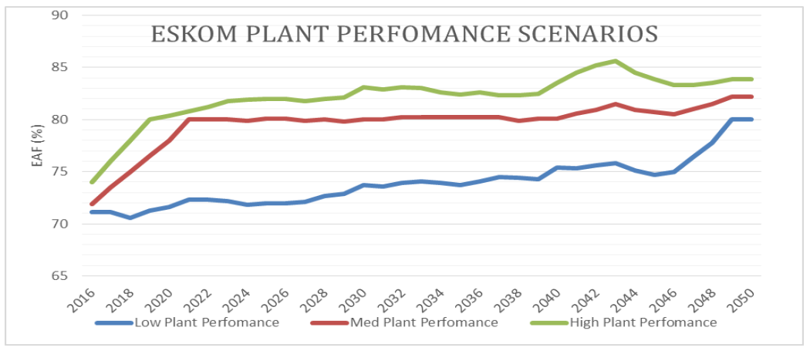
Eskom plant performance scenarios
Source: Eskom

Slide 57
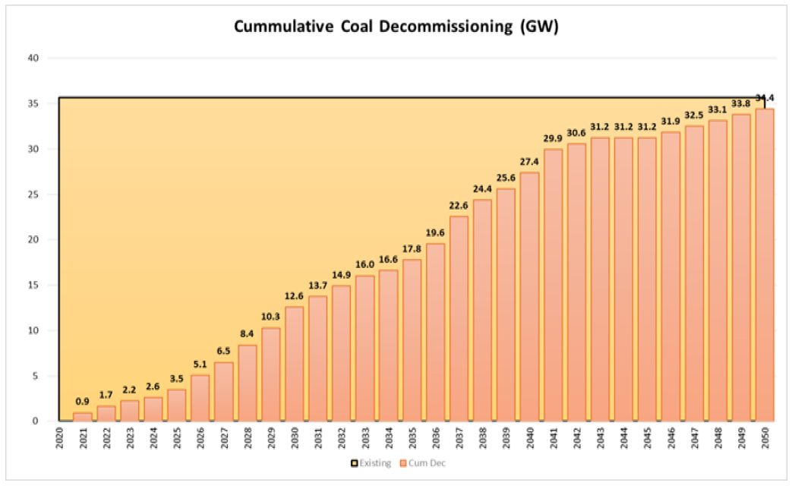
Cumulative Eskom coal plants decommissioning
Source: IRP Update Draft Report 2018

Slide 58
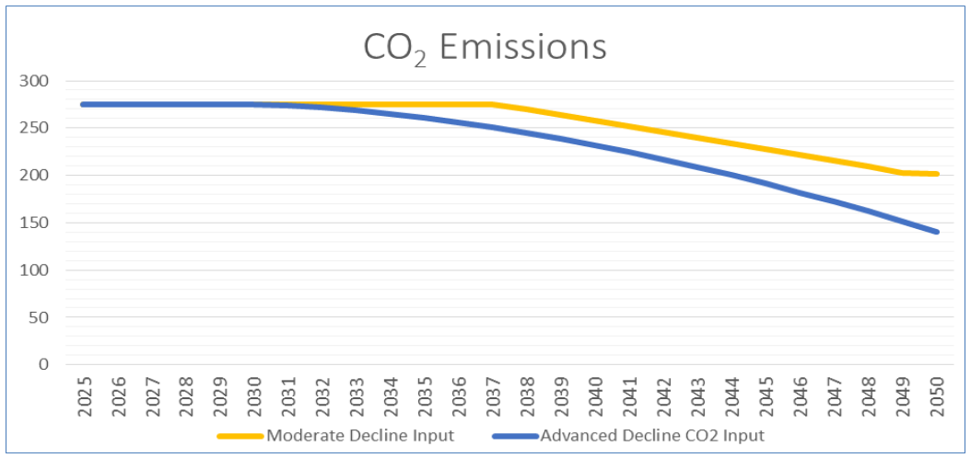
Emission reduction trajectory
Source: IRP Update Draft Report 2018

Slide 59
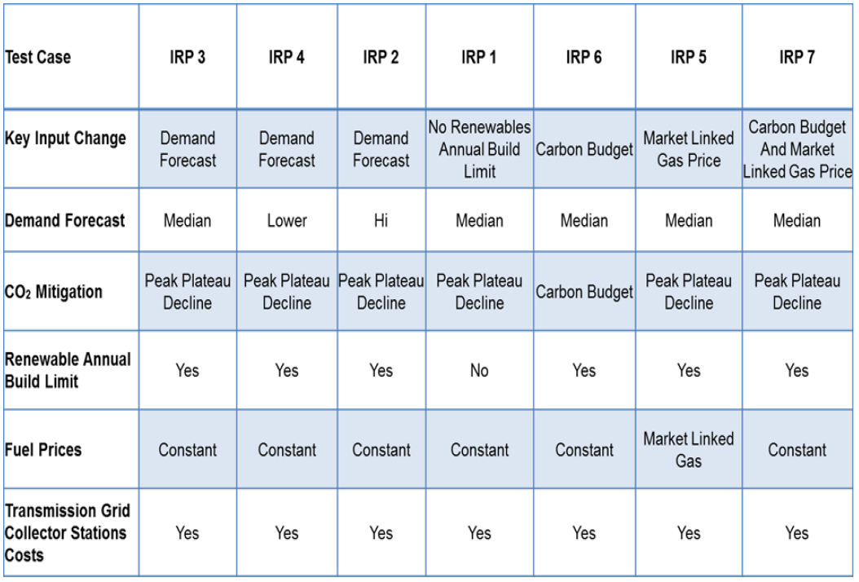
IRP Scenarios
Source: IRP Update Draft Report 2018

Slide 60
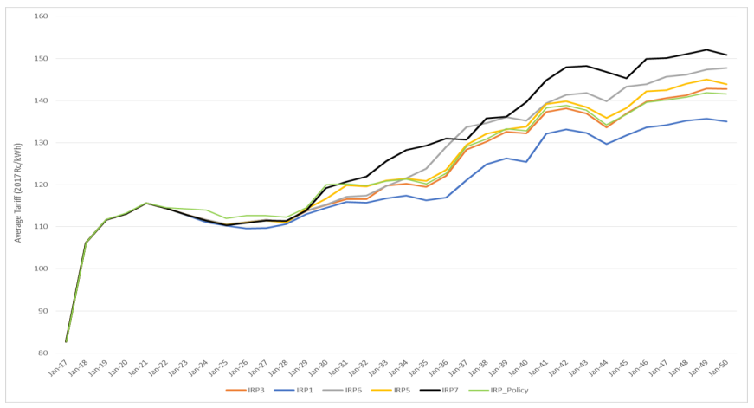
Comparison of tariffs for IRP scenarios (ZAc/kWh) in 2017 Terms
Source: IRP Update Draft Report 2018
Notes:
Even if tariffs stay the same or slightly increase,

Slide 61
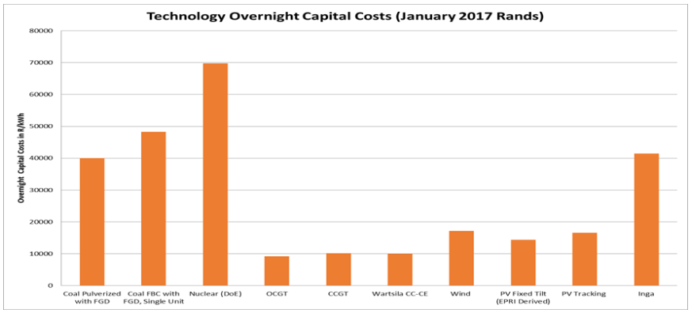
Generation technology overnight capital costs (Jan 2017 Rands)
Source: IRP Update Draft Report 2018

Slide 62
Financial ratios
Source: SAIEE/EE Publishers Seminar/Panel Discussion 2018

Slide 63
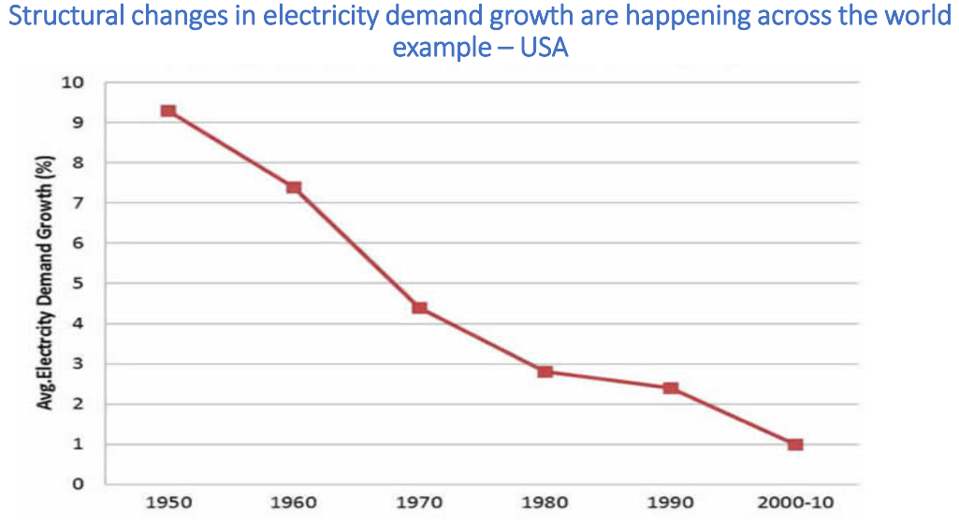
Eskom losses – likely to increase
Source: SAIEE/EE Publishers Seminar/Panel Discussion 2018

Slide 64
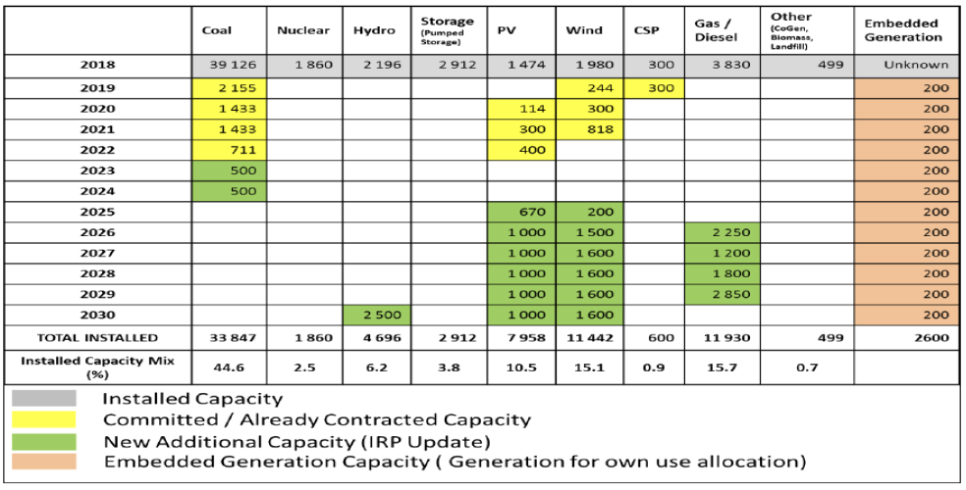
Eskom losses – likely to increase
Source: SAIEE/EE Publishers Seminar/Panel Discussion 2018

Slide 65
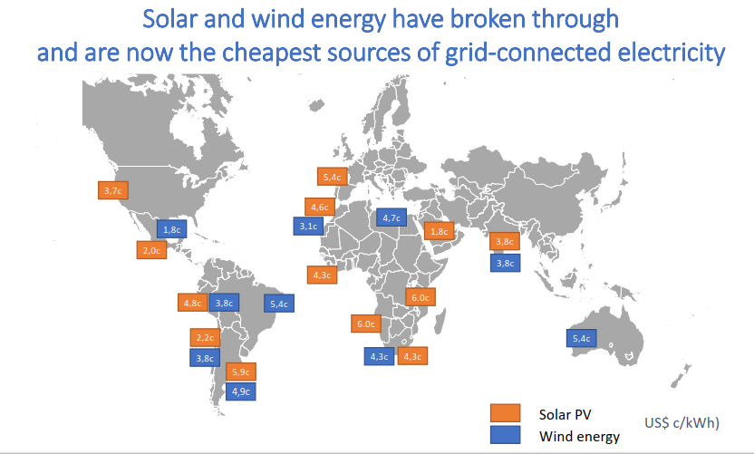
VRE and Storage Revolution
Source: SAIEE/EE Publishers Seminar/Panel Discussion 2018

Slide 66
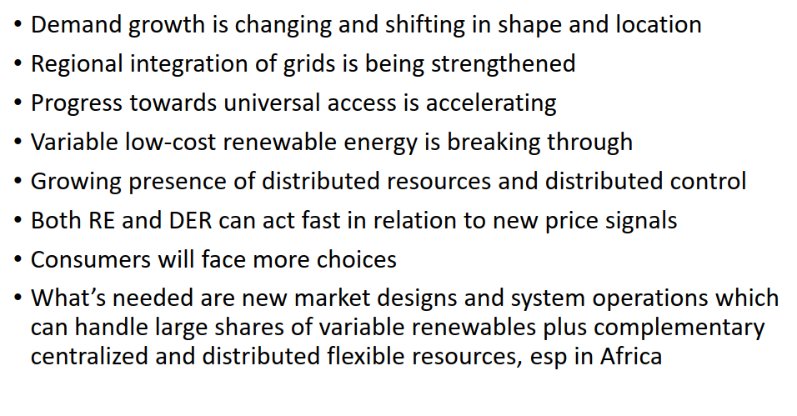
Rate of change in power sector
Source: SAIEE/EE Publishers Seminar/Panel Discussion 2018

